Slide 1
Case Study on Data Build Tool (DBT)
By -
Ayushi Pande

Slide 2
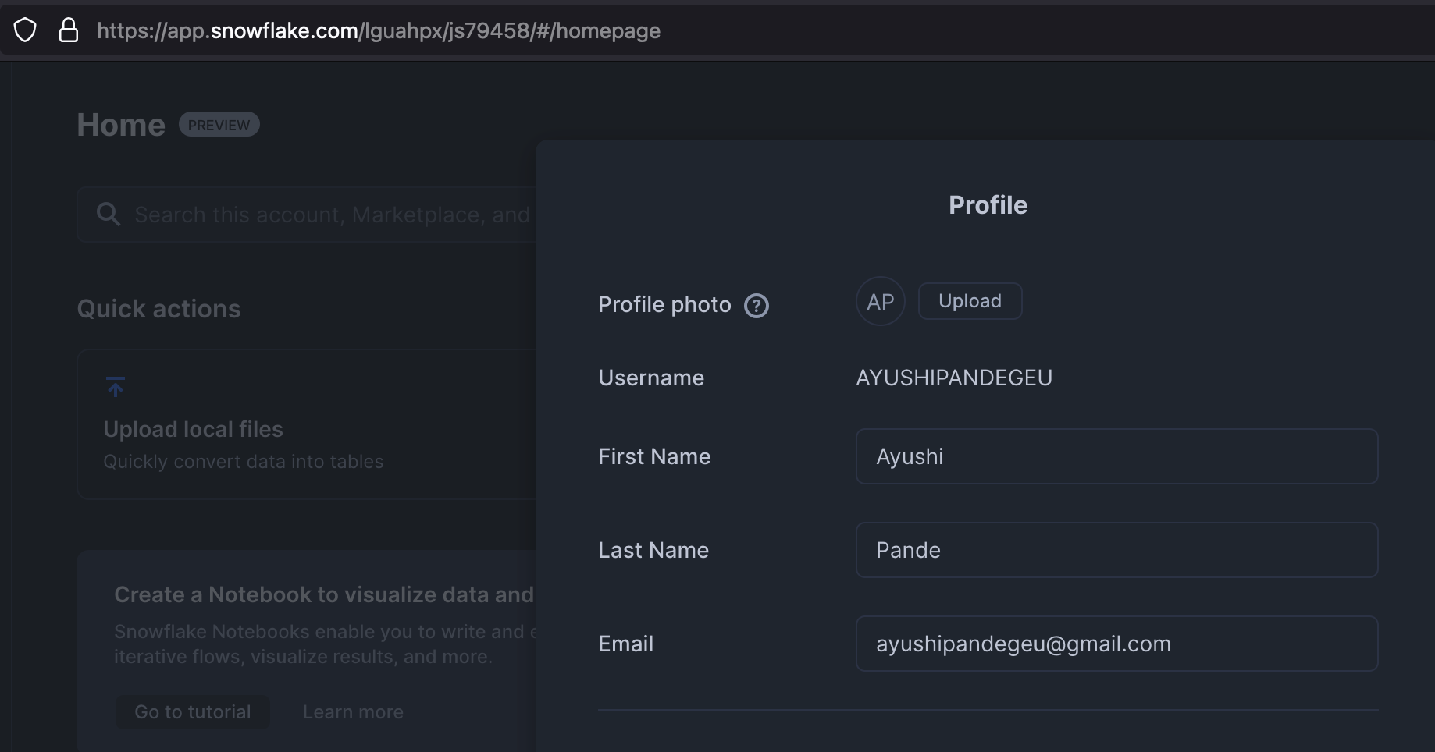
Created Snowflake account

Slide 3
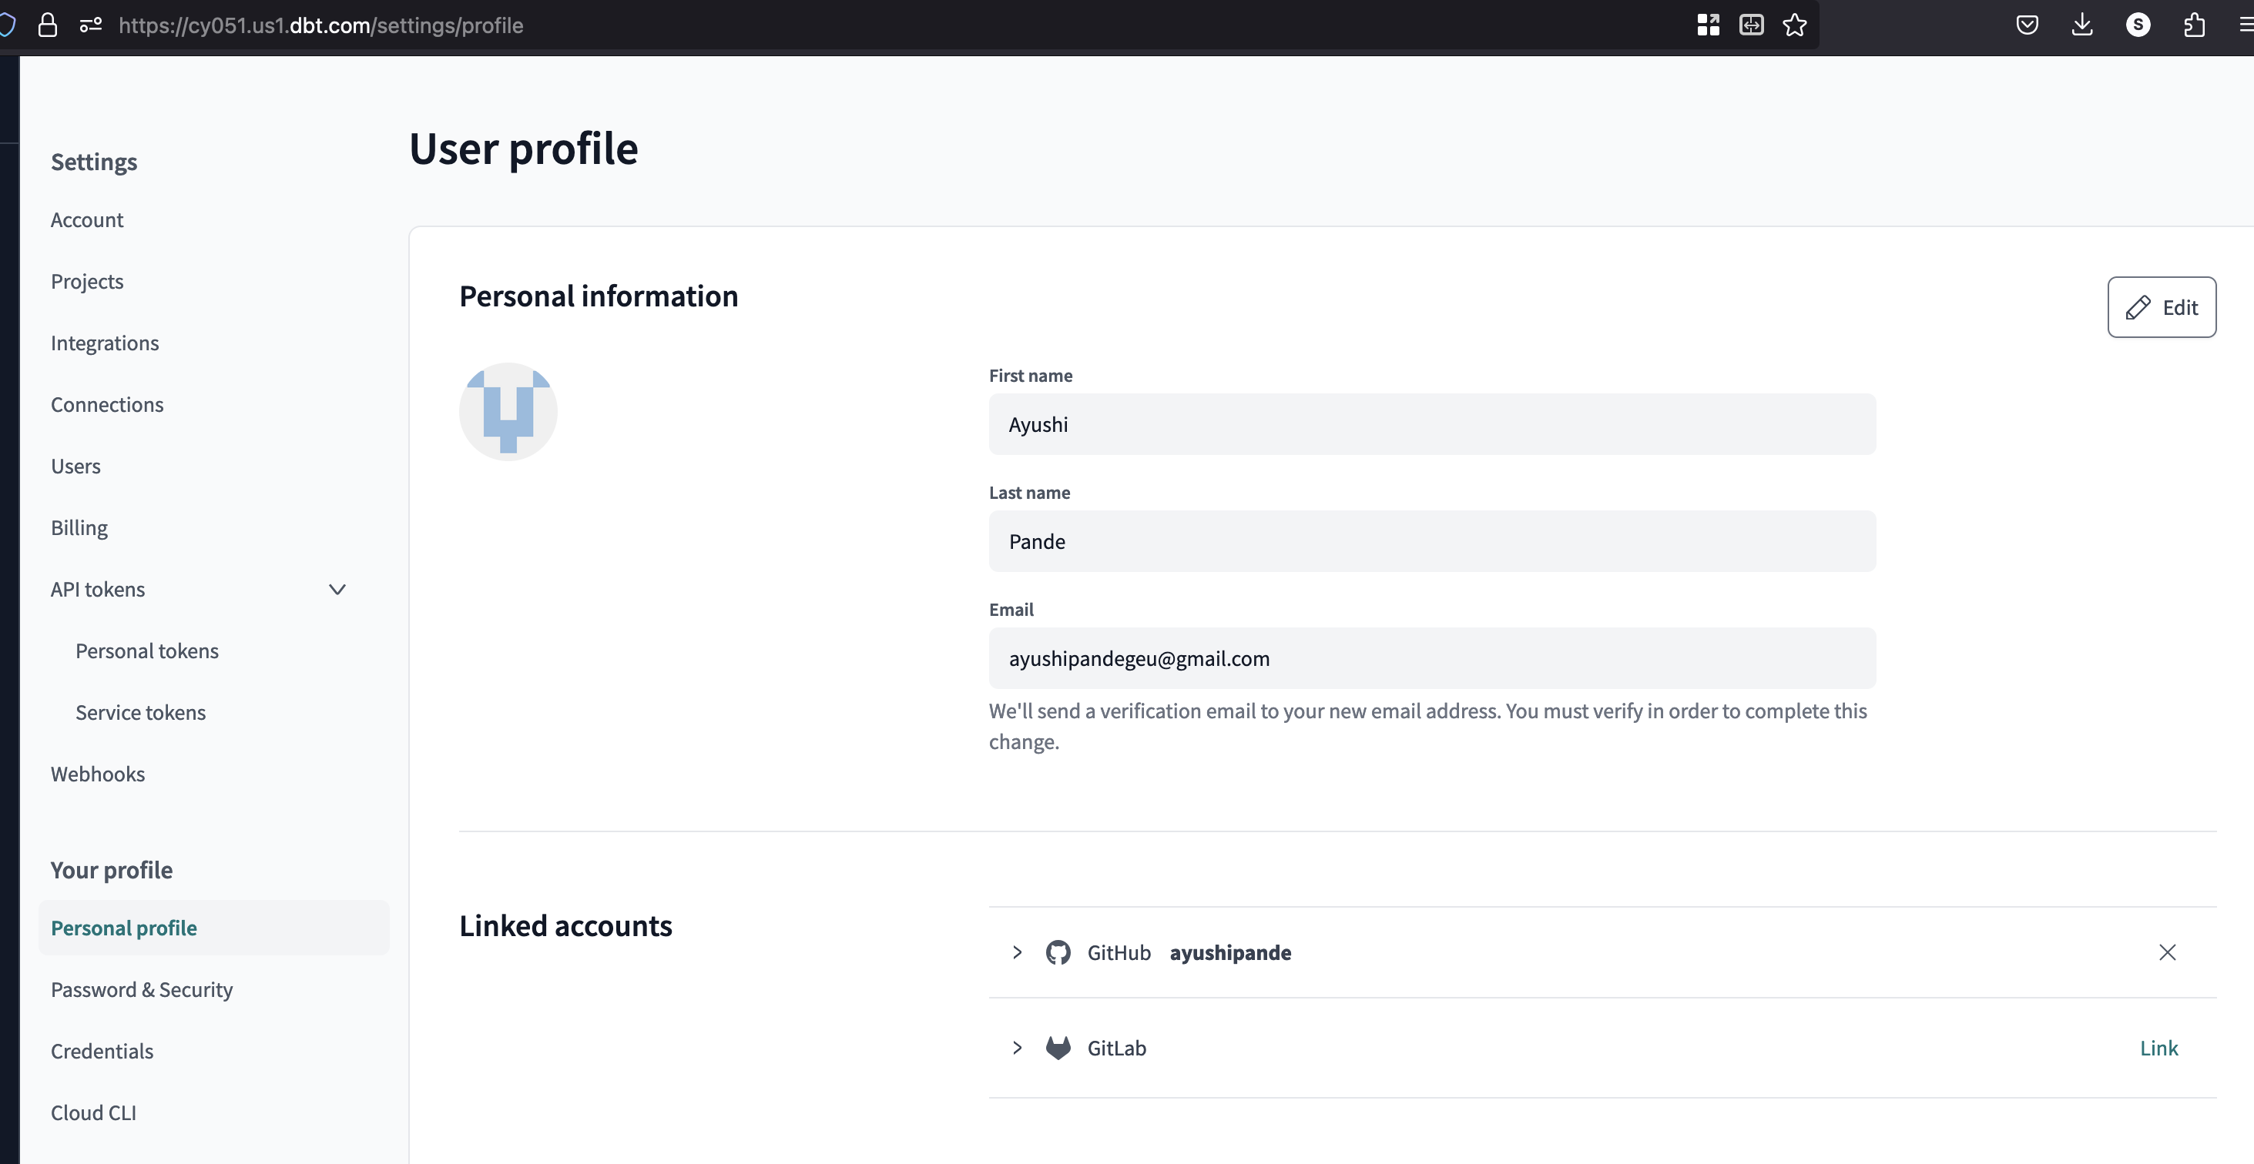
Created account for DBT Cloud

Slide 4
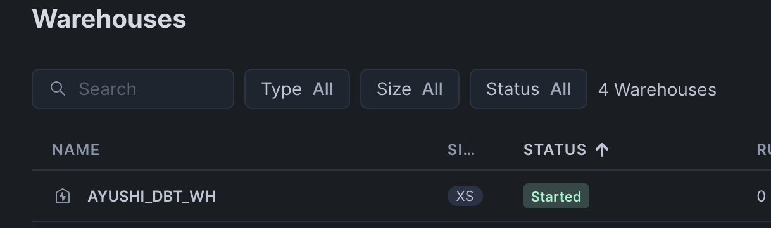
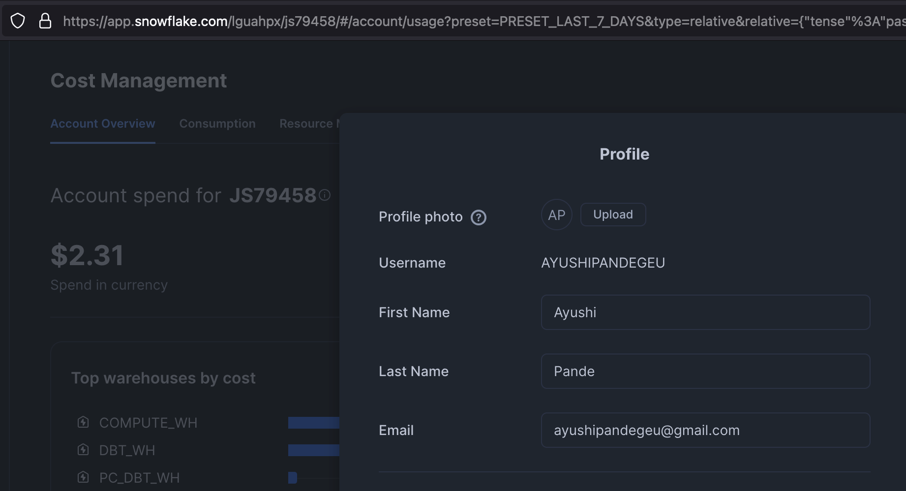
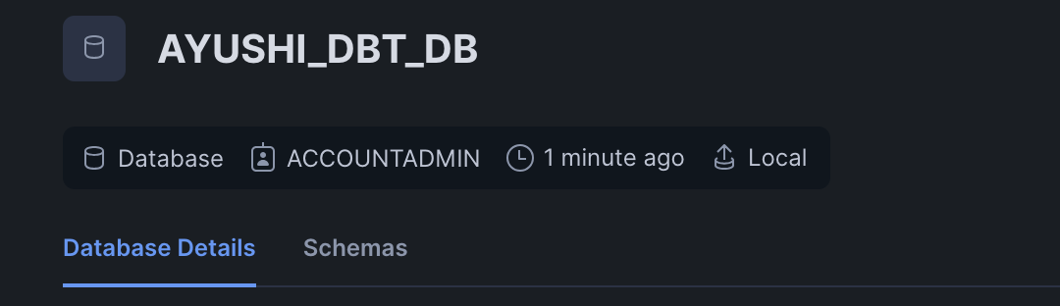
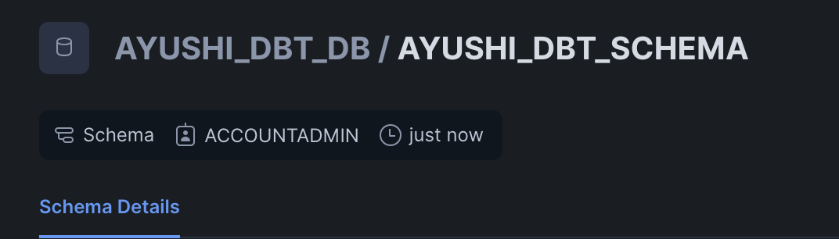
Created Warehouse – AYUSHI_DBT_WH
Created Database – AYUSHI_DBT_DB
Created Schema – AYUSHI_DBT_SCHEMA

Slide 5
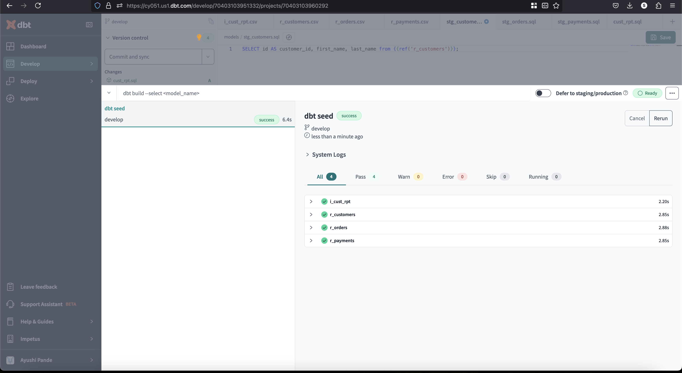
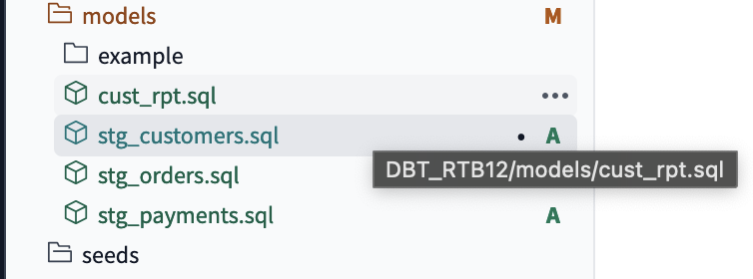
Data Loading
Seeding – Created files in seed folder in project

Slide 6
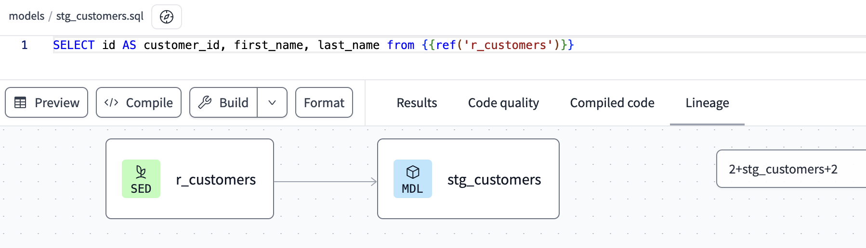
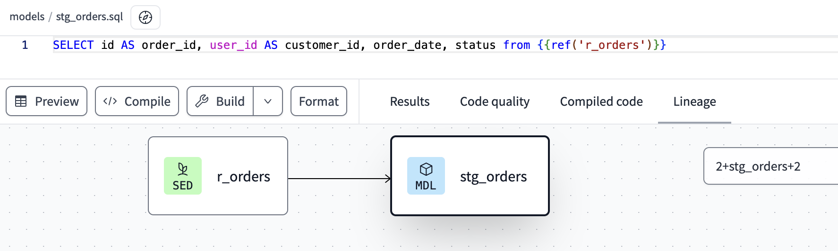
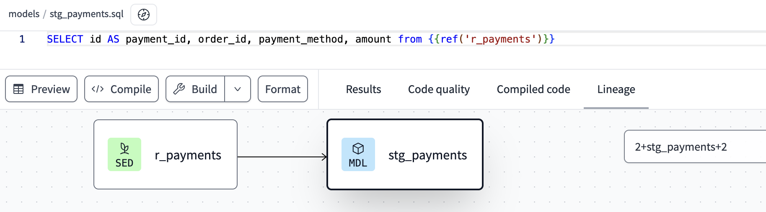
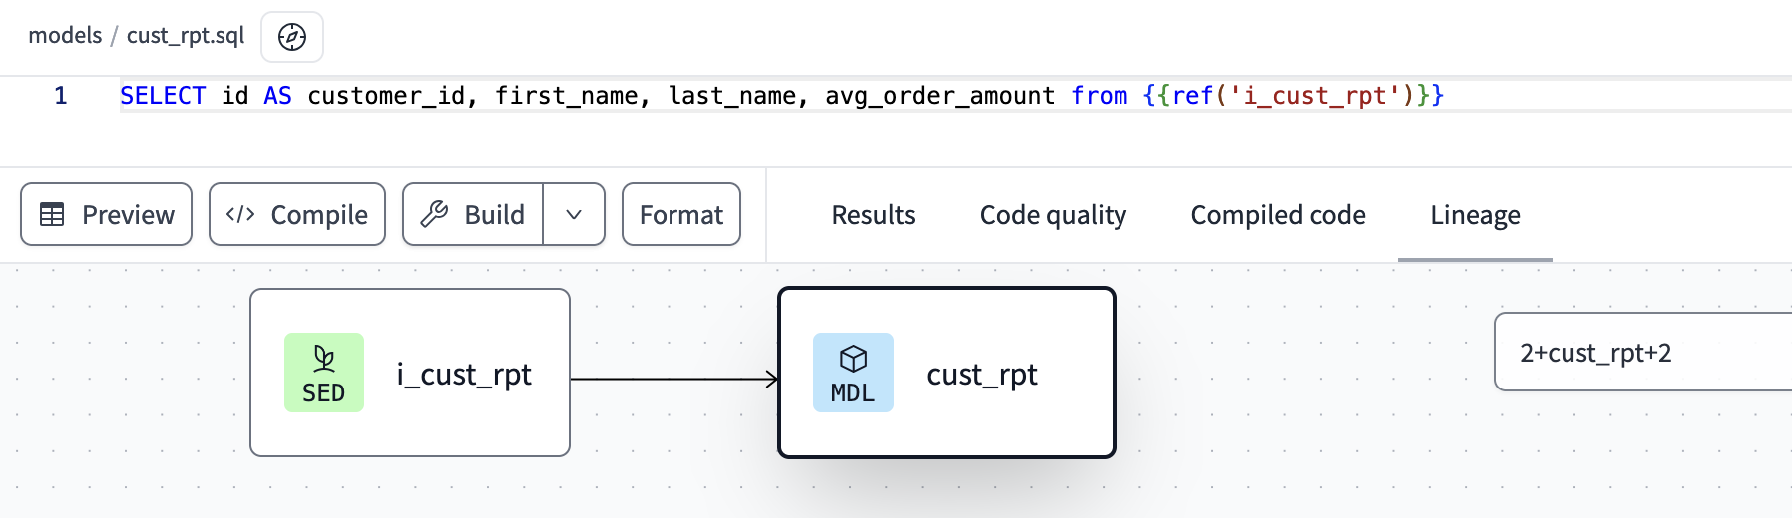
Created staging dbt models which reads the tables created in the data loading

Slide 7
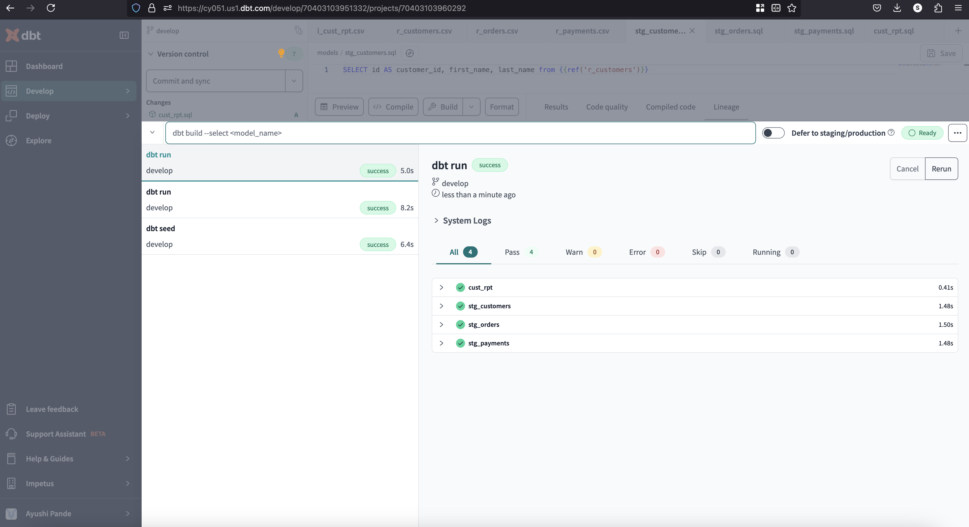
Executed model with “dbt run” command

Slide 8
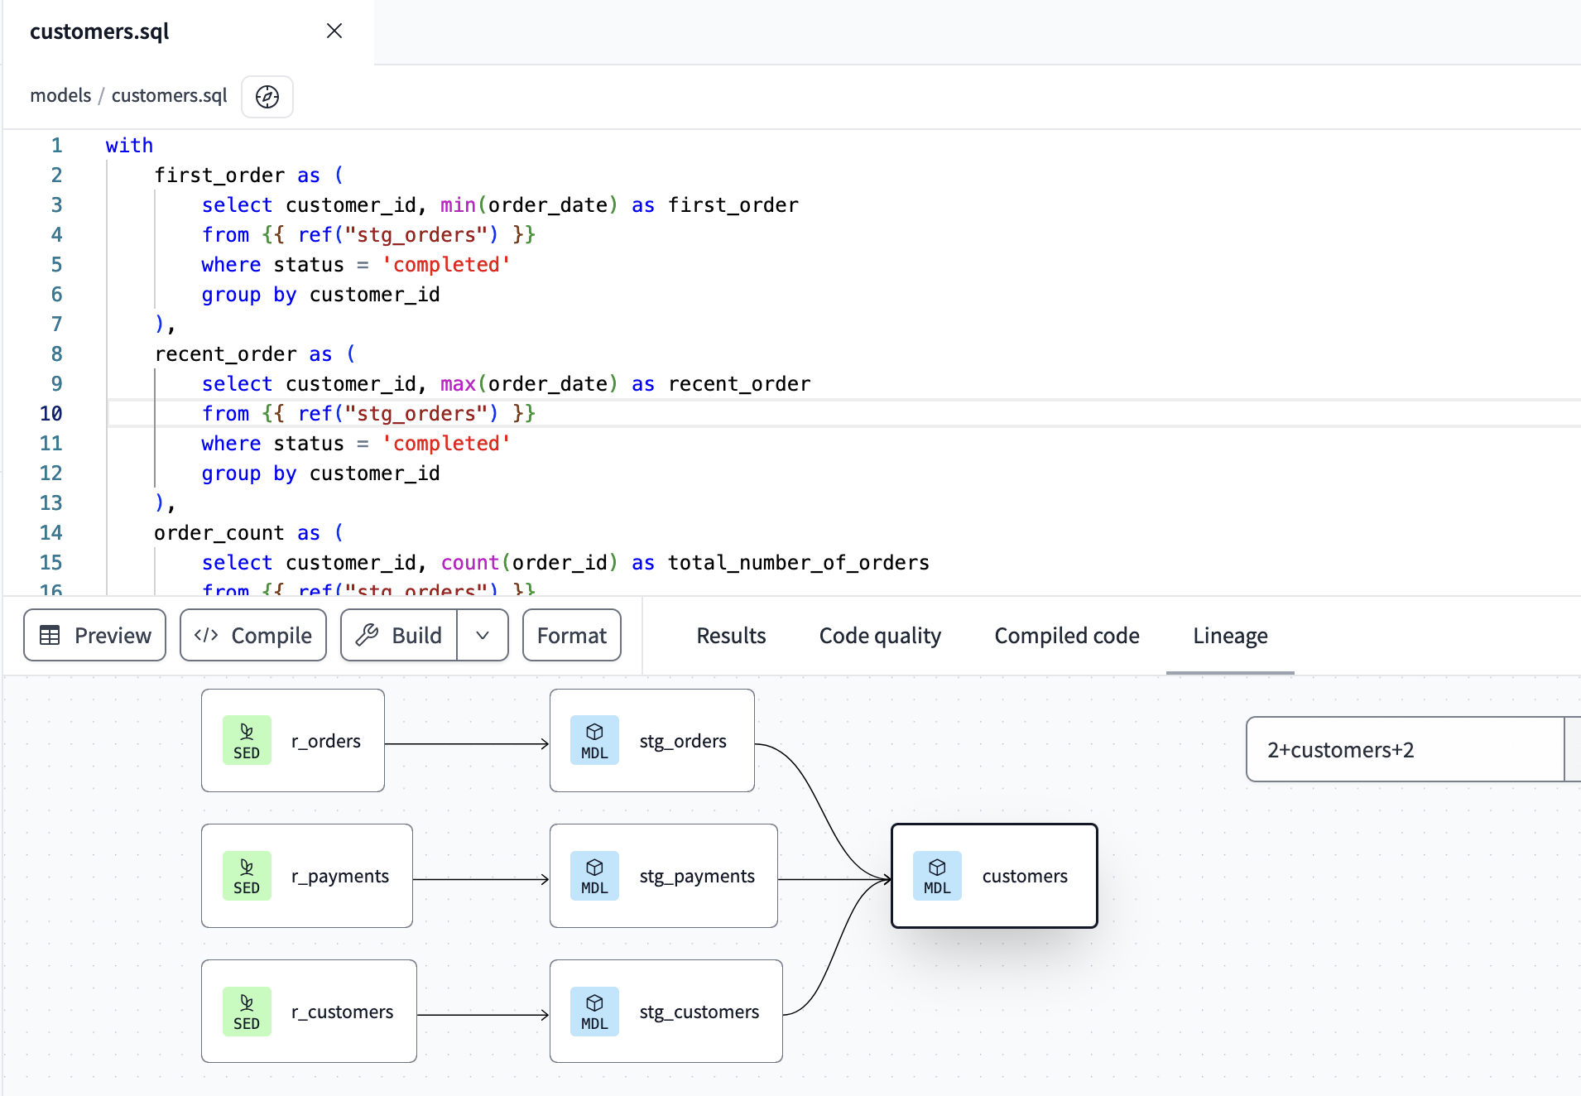
Referred tables created in "dbt Staging Model" and created a SQL model with required transformations
"customers": Model retrieves customer-related information including their customer id, first and last names, along with details about their orders (first order, most recent order, and total number of orders) and lifetime value calculated from their total payments on orders.

Slide 9
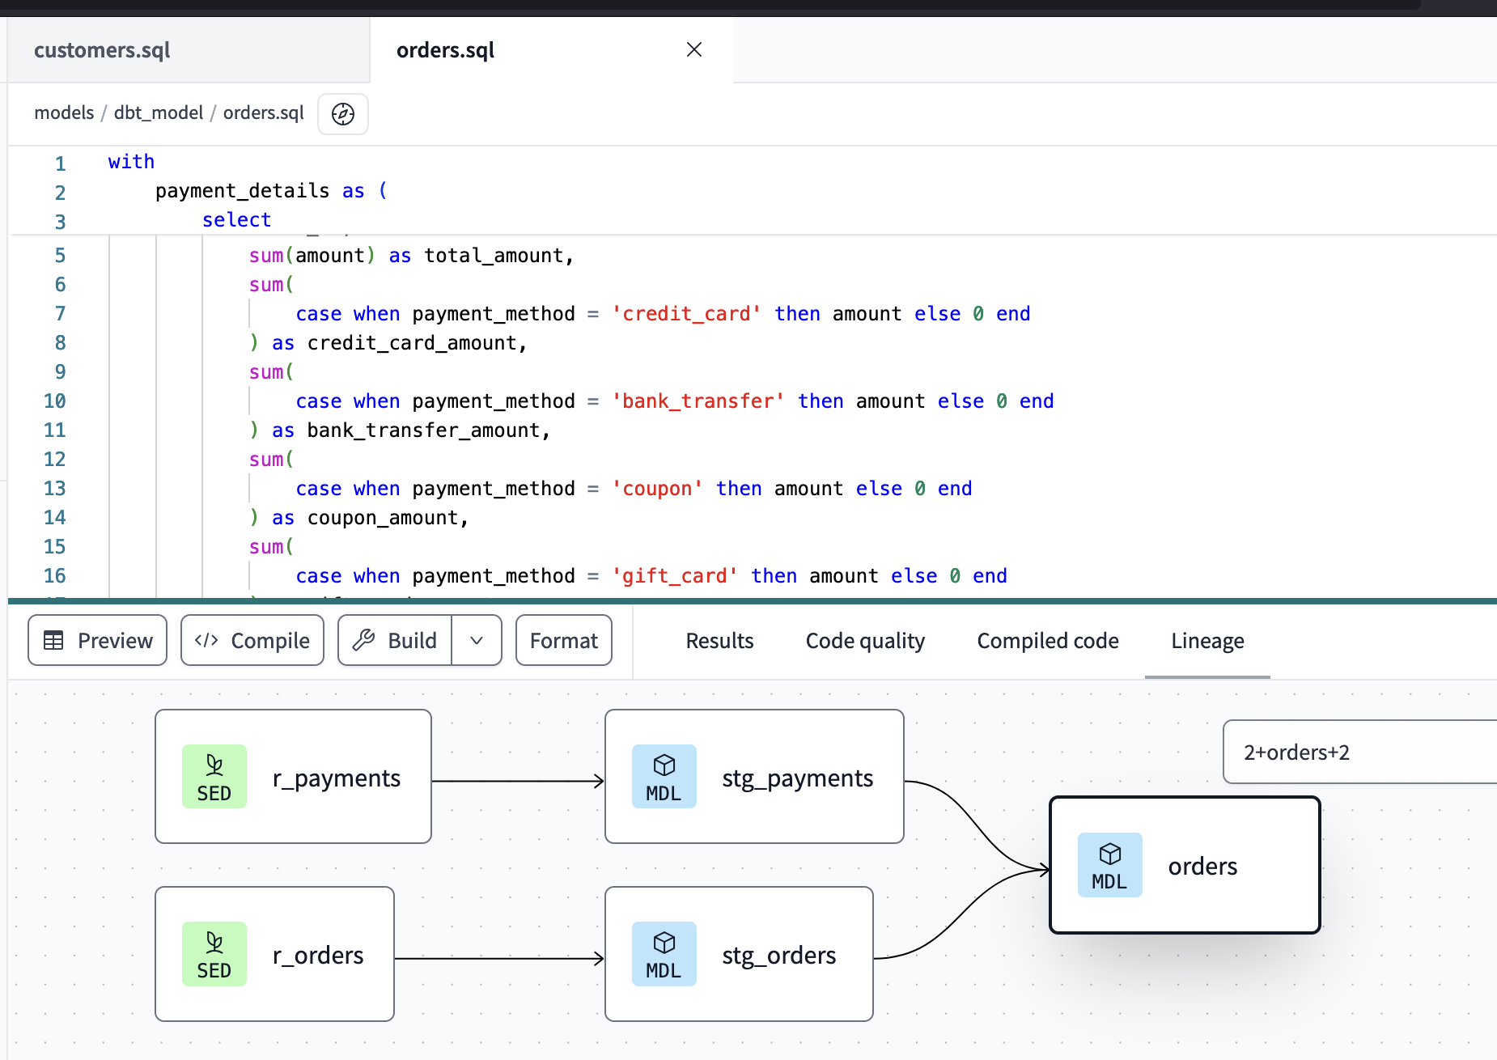
"orders": Model retrieves order-related information including their order id, customer id, order date, order status, total amount and total amount for each payment methods such as 'credit_card', 'coupon', 'bank_transfer' and 'gift_card’.

Slide 10
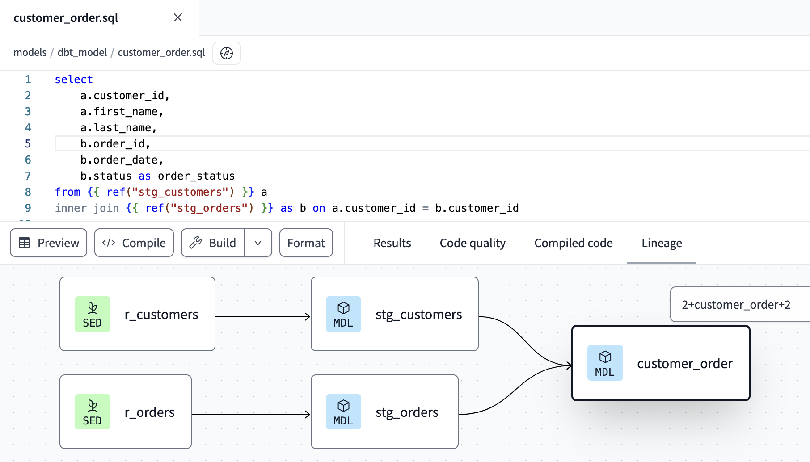
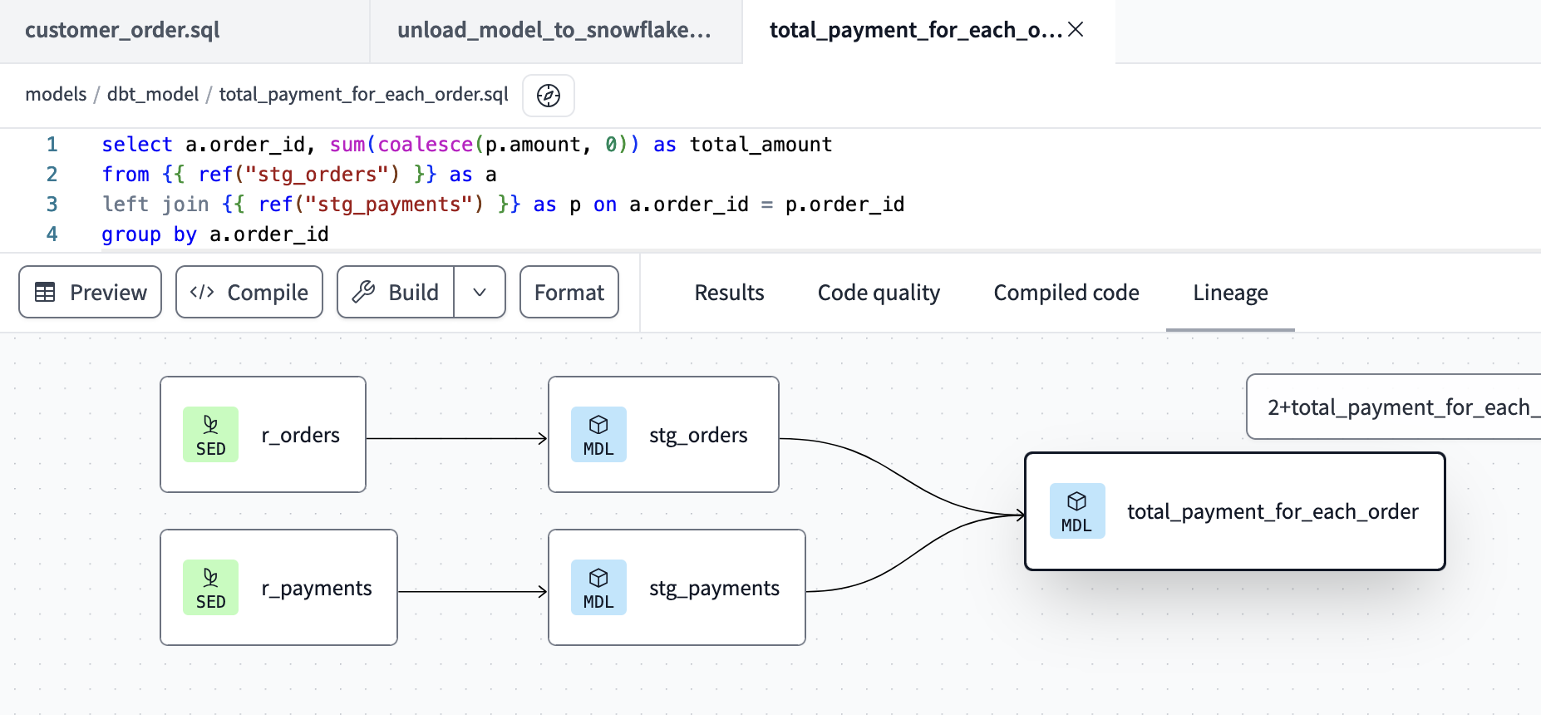
"customer_order": Get Customer Orders from the stage.
"total_payment_for_each_order": Calculating Total Payments for Each Order.

Slide 11
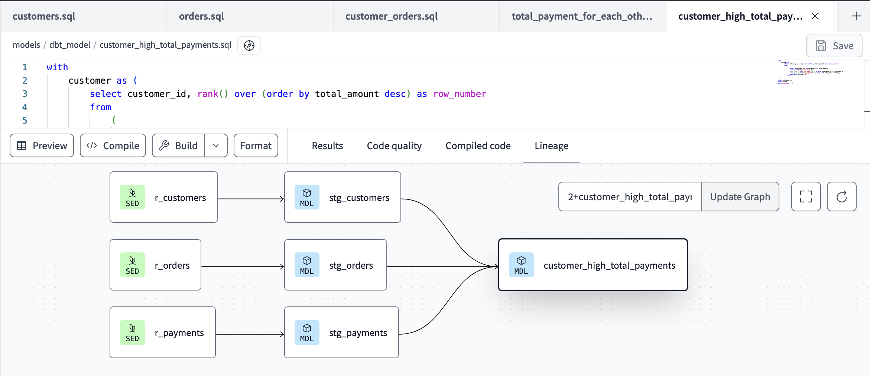
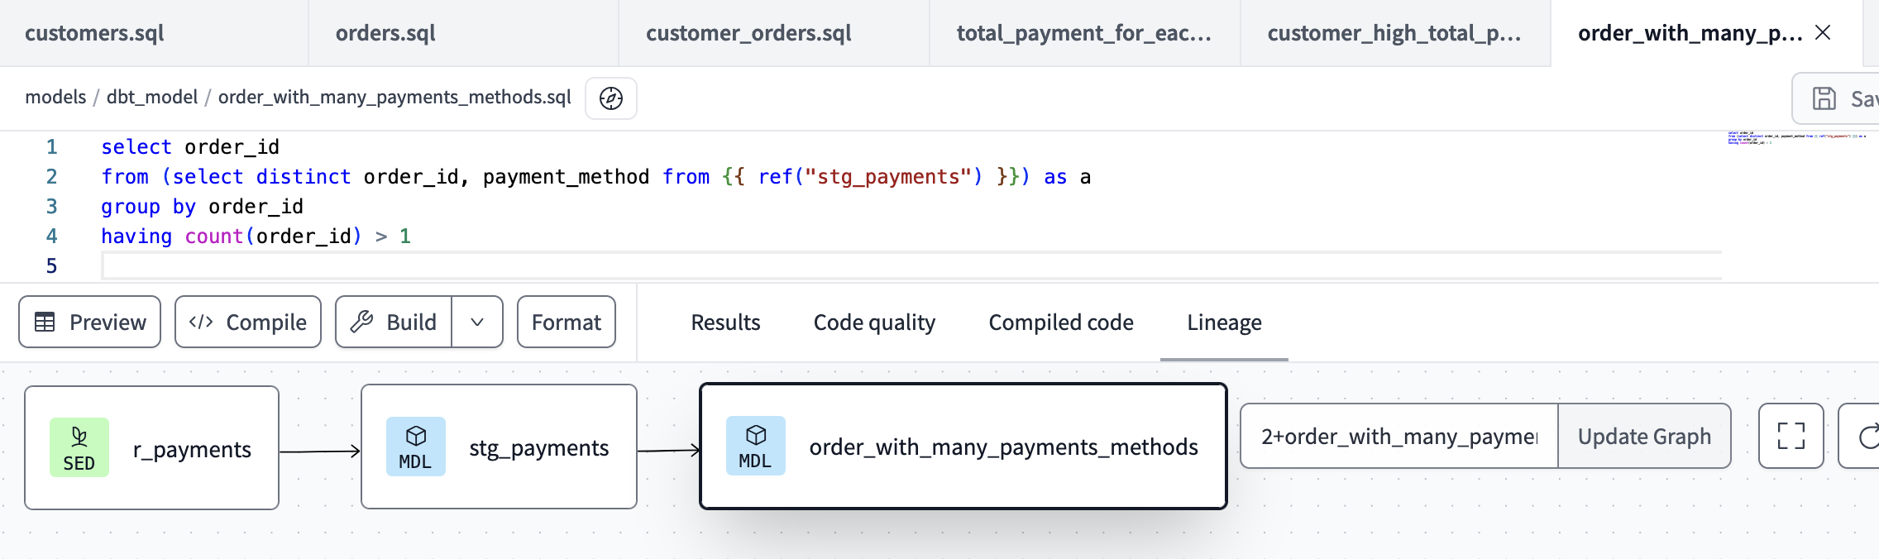
"customer_high_total_payments": Finding Customers with Highest Total Payments.
"order_with_many_payments_methods": Identifying Orders with Multiple Payment Methods.

Slide 12
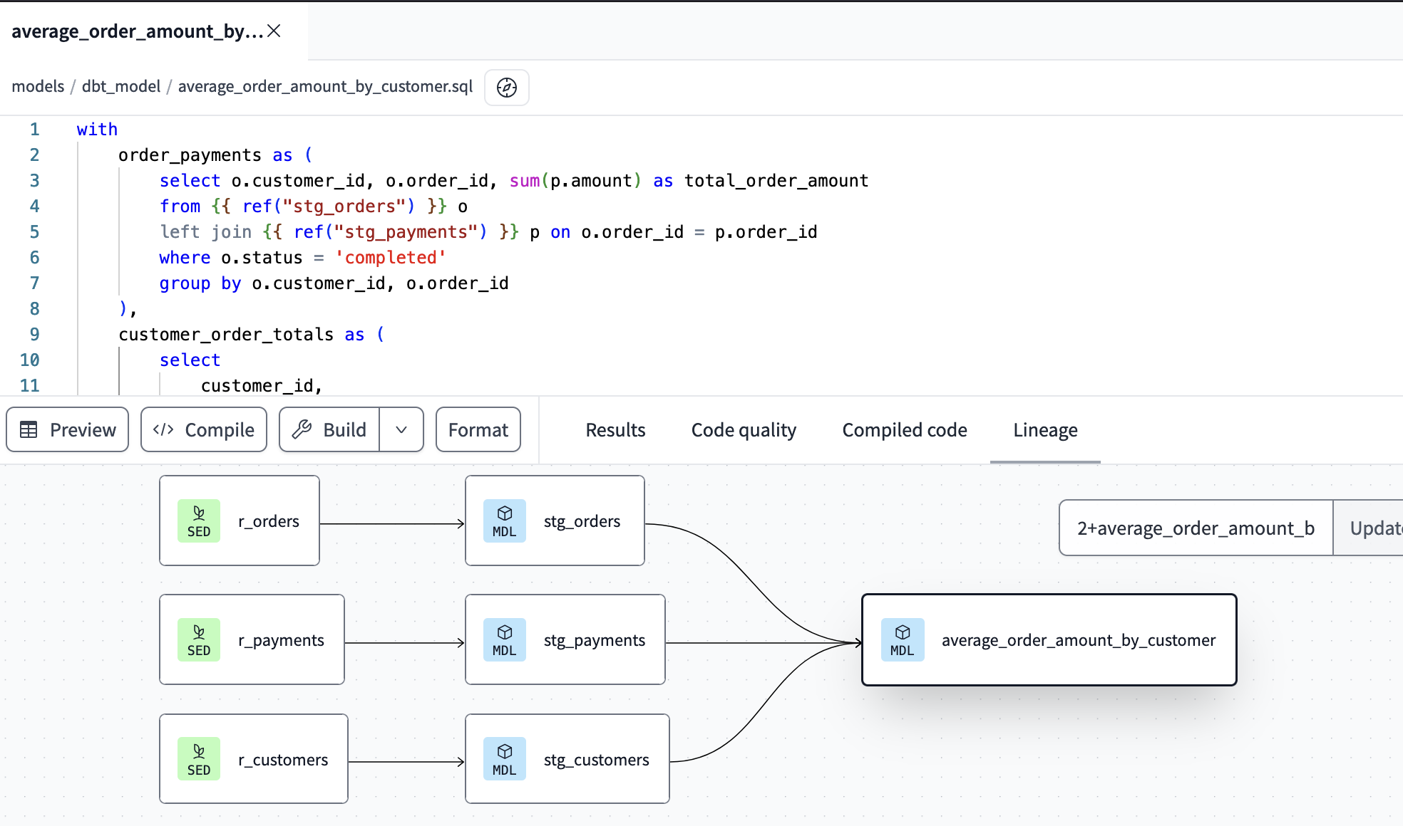
"Average_Order_Amount_by_Customer": Calculating Average Order Amount by Customer.

Slide 13
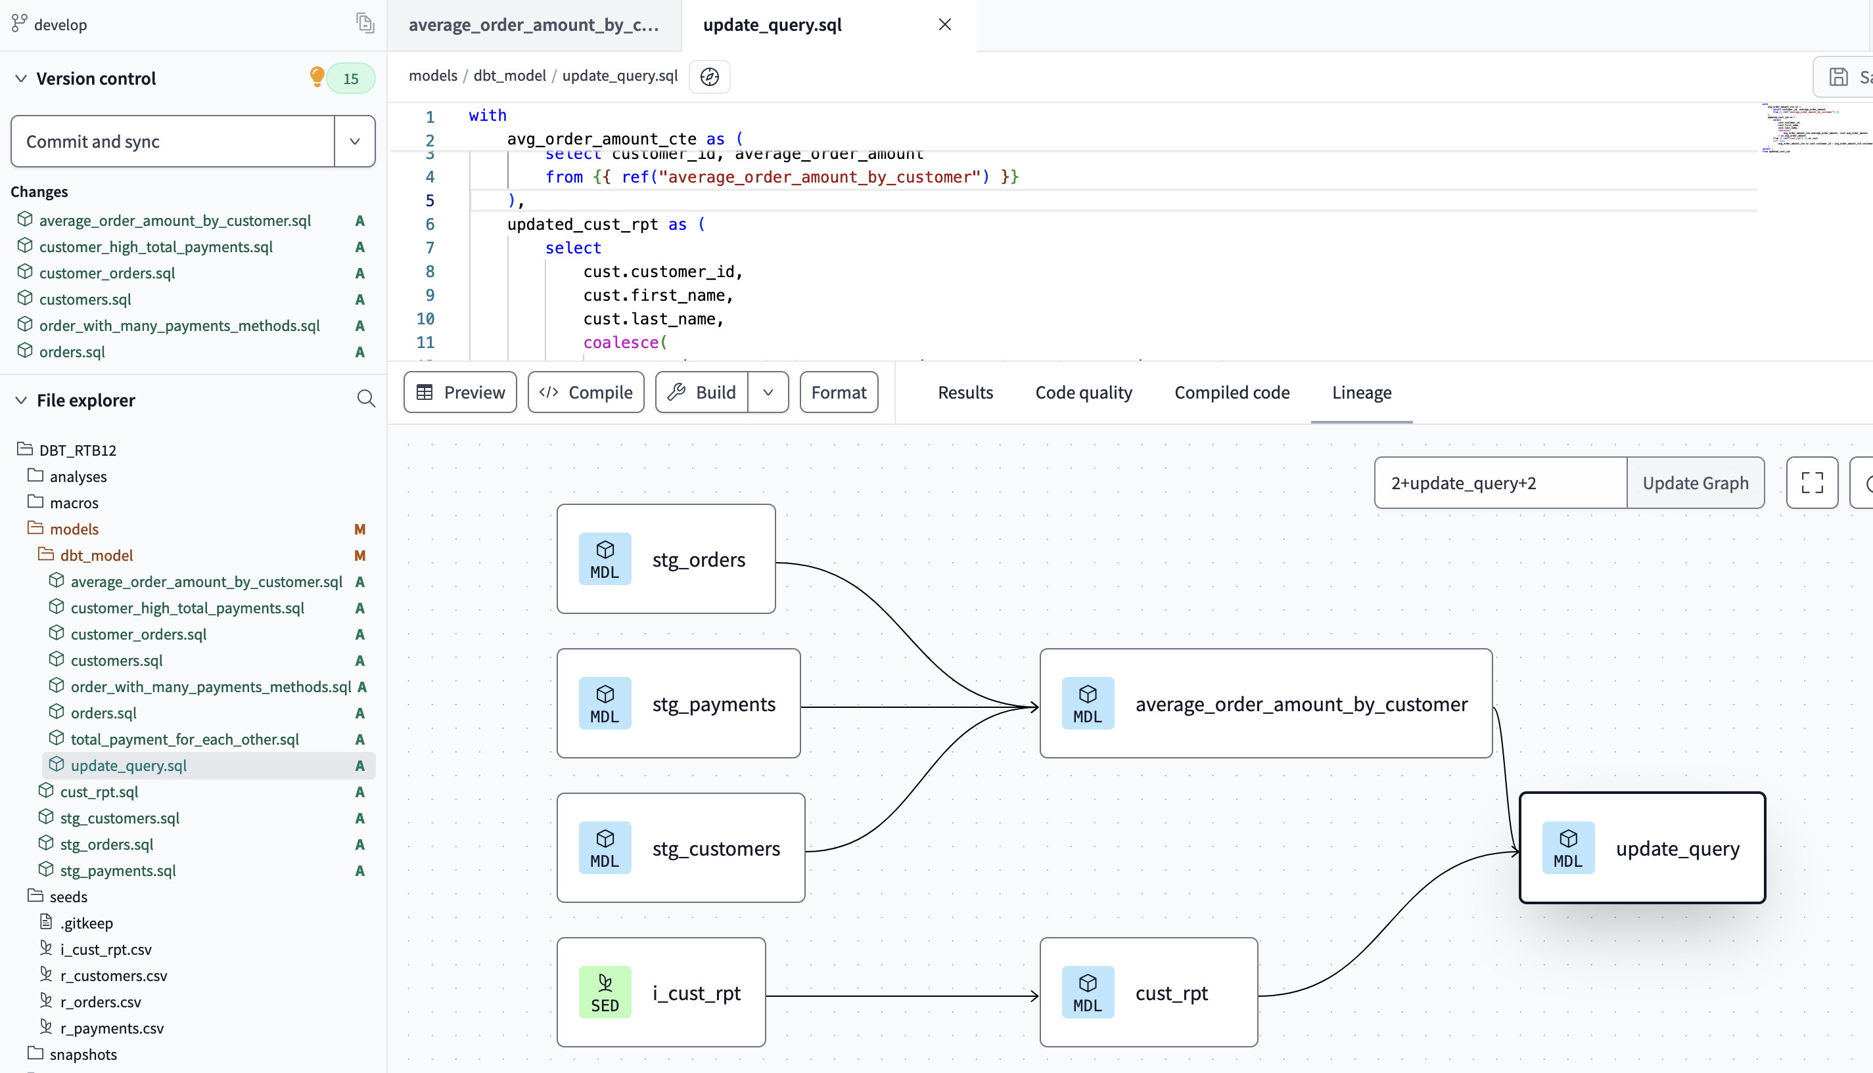
"Update query": Write query that updates the AVG_ORDER_AMOUNT column in the "CUST_RPT" table with values from the corresponding column in a AVERAGE_ORDER_AMOUNT_BY_CUSTOMER, matching rows based on their CUSTOMER_ID.

Slide 14
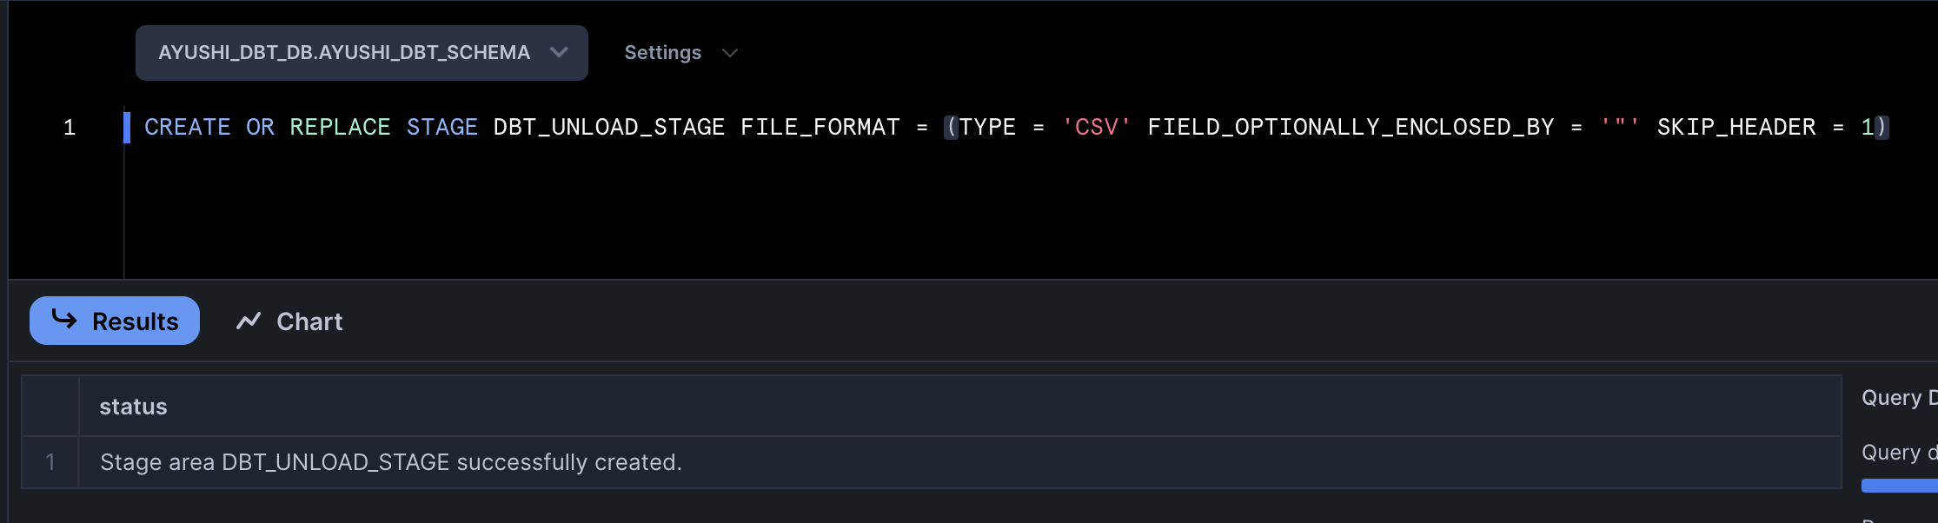
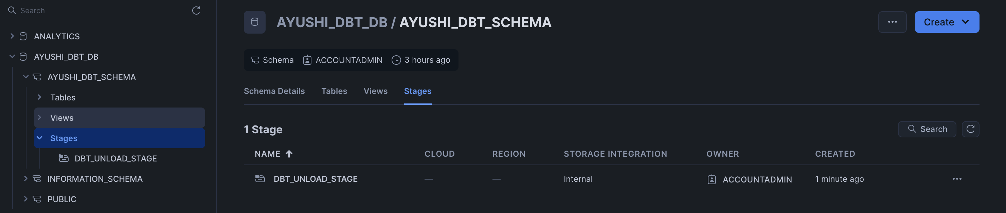
Exporting Models to Snowflake’s Named Stage
Created Stage in Snowflake

Slide 15
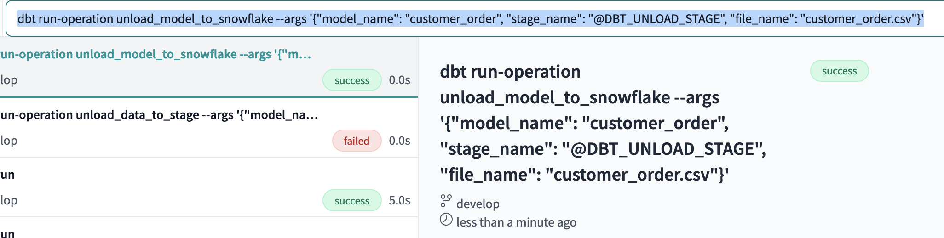
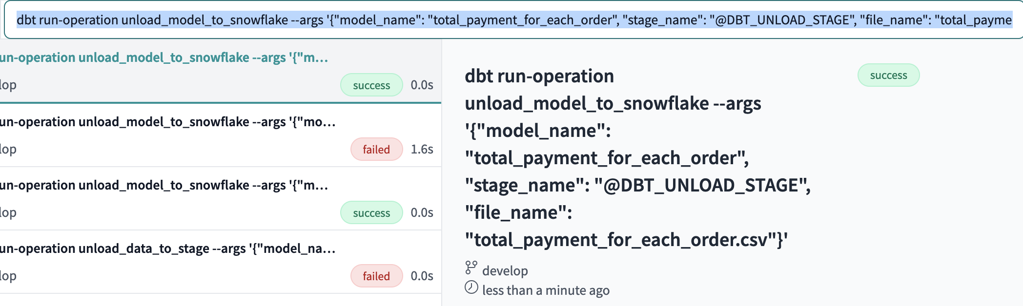
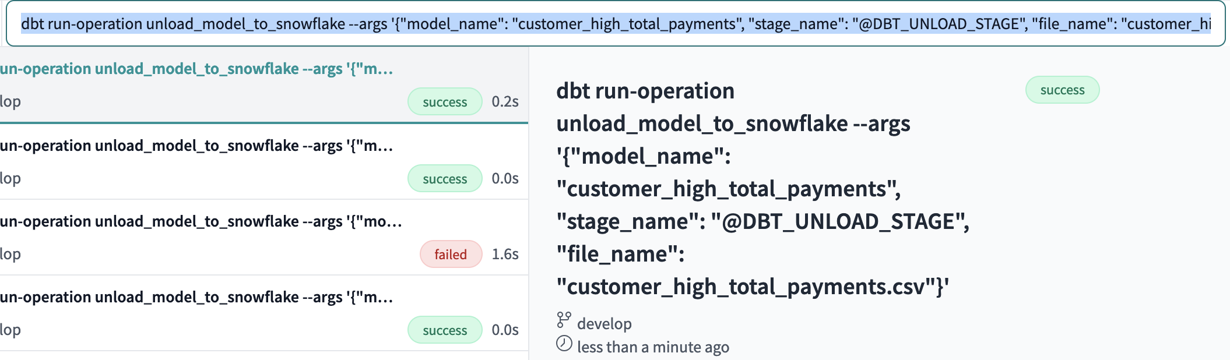
Unloading models to Snowflake’s stage
“customer_order”: dbt run-operation unload_model_to_snowflake --args '{"model_name": "customer_order", "stage_name": "@DBT_UNLOAD_STAGE", "file_name": "customer_order.csv"}'
“total_payment_for_each_order”: dbt run-operation unload_model_to_snowflake --args '{"model_name": "total_payment_for_each_order", "stage_name": "@DBT_UNLOAD_STAGE", "file_name": "total_payment_for_each_order.csv"}'
“customer_high_total_payments”: dbt run-operation unload_model_to_snowflake --args '{"model_name": "customer_high_total_payments", "stage_name": "@DBT_UNLOAD_STAGE", "file_name": "customer_high_total_payments.csv"}'

Slide 16
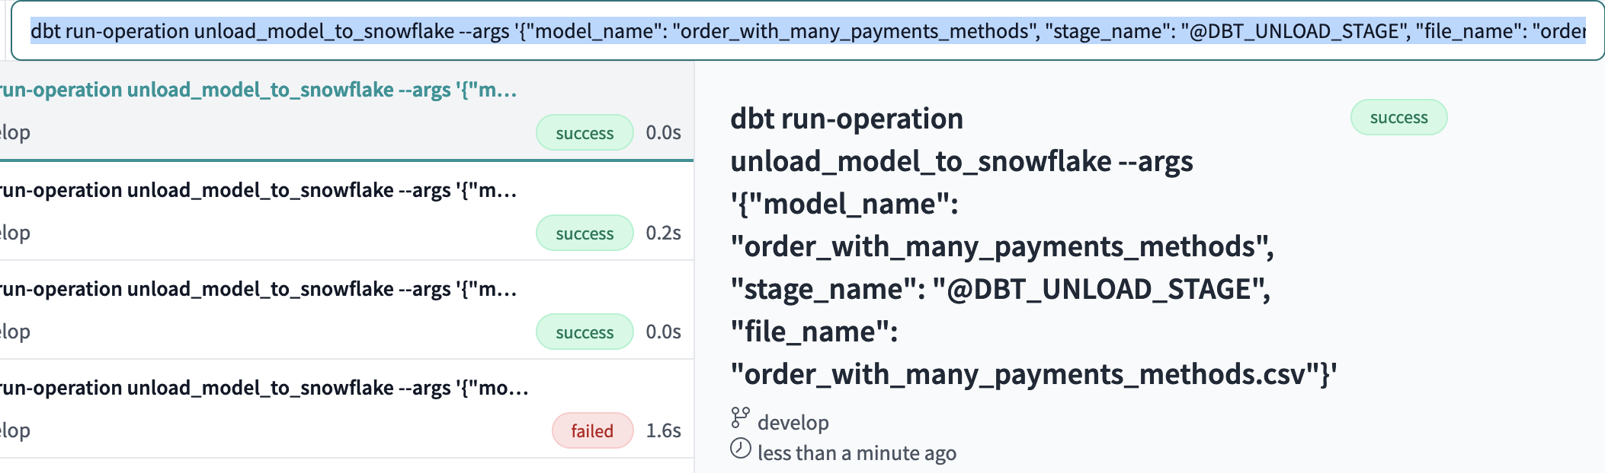
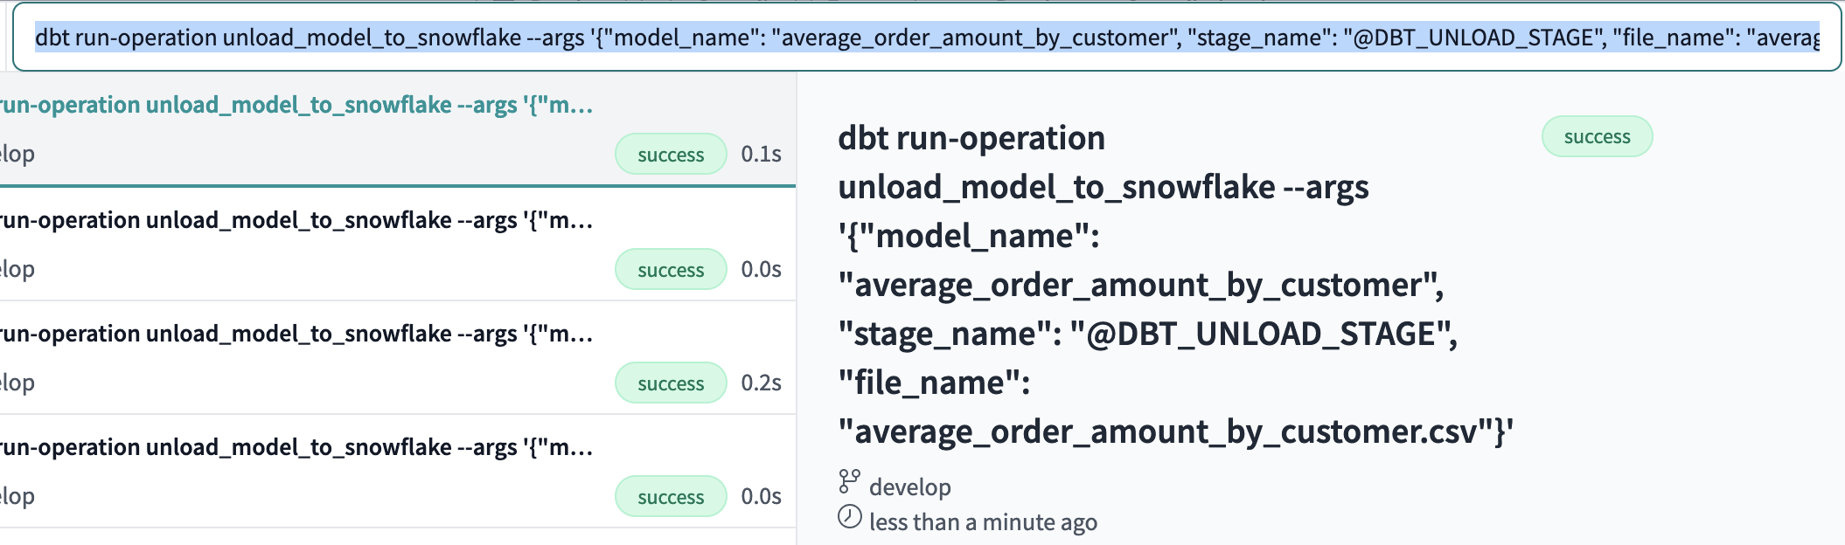
“order_with_many_payments_methods”: dbt run-operation unload_model_to_snowflake --args '{"model_name": "order_with_many_payments_methods", "stage_name": "@DBT_UNLOAD_STAGE", "file_name": "order_with_many_payments_methods.csv"}'
“average_order_amount_by_customer”: dbt run-operation unload_model_to_snowflake --args '{"model_name": "average_order_amount_by_customer", "stage_name": "@DBT_UNLOAD_STAGE", "file_name": "average_order_amount_by_customer.csv"}'

Slide 17
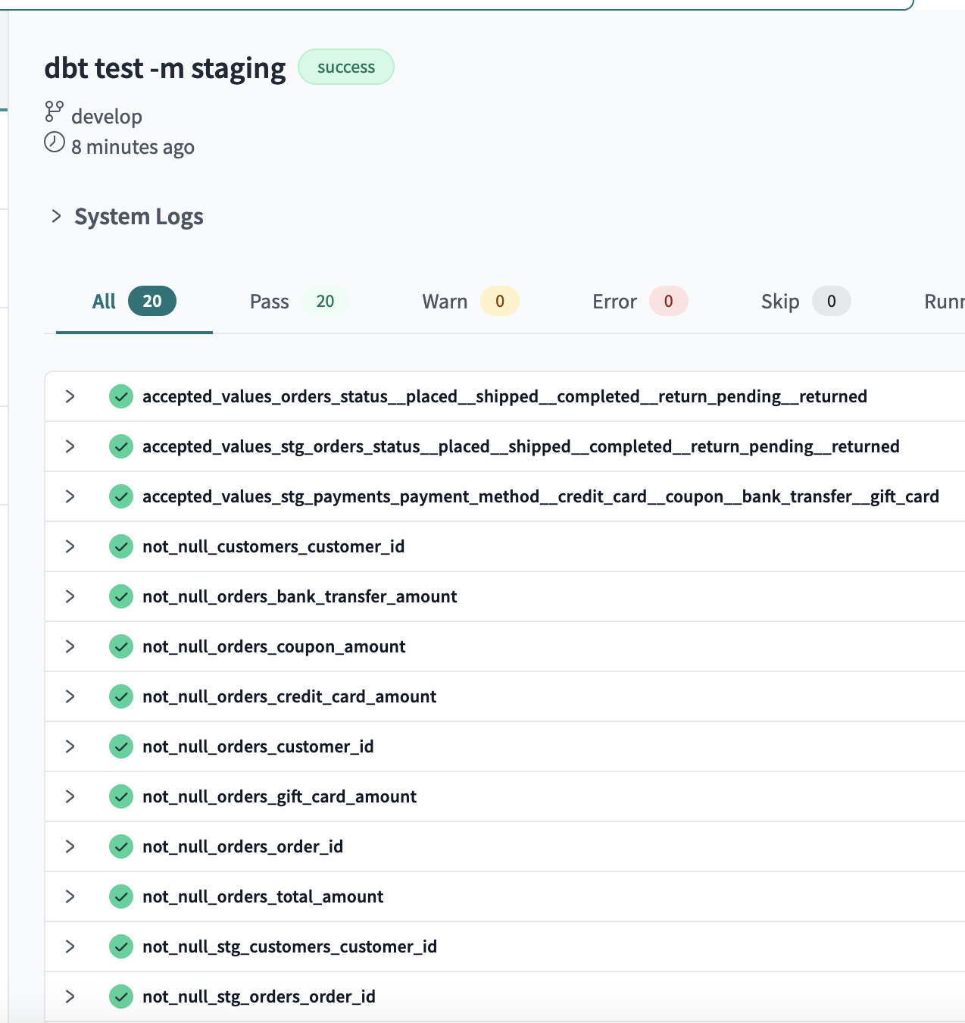
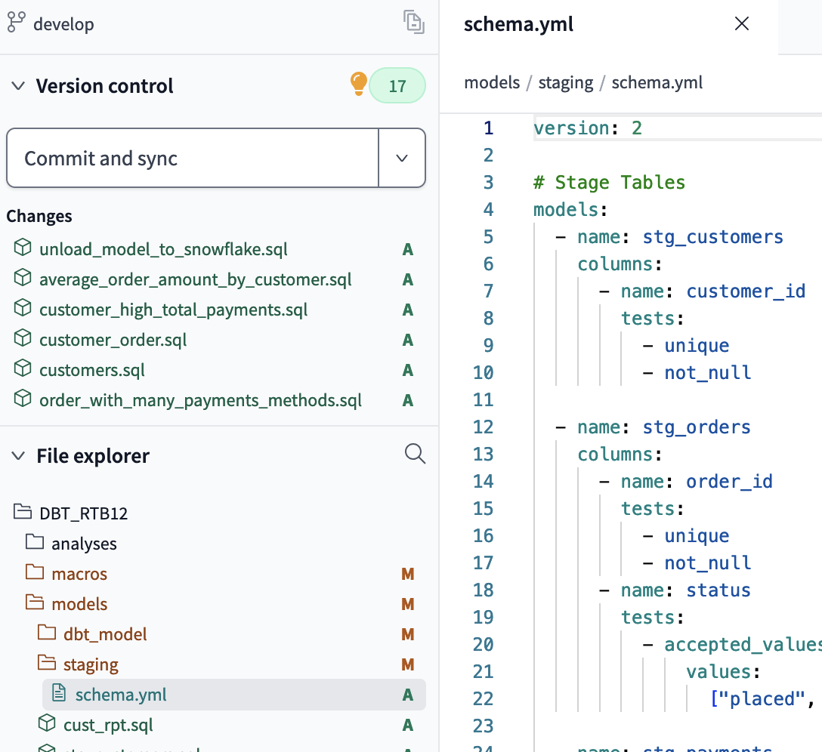
Executing Tests

Slide 18
Thank You!

